Slide 1


AWARENESS TO POLICIES AND PROCEDURE USAGE
Guiding Excellence Through Policies and Procedures

Slide 2

TODAY YOU WILL LEARN
An introduction to Policies and Procedures.
Importance of Policies and Procedures.
Benefits of Policies and Procedures.
Key elements of Policies and Procedures.
Developing and Implementing Policies and Procedures.
Policy Implementation and Monitoring.
Policy Enforcement and Consequences.
Policy Governance and Review Board.

Slide 3
TODAY YOU WILL LEARN (CONTD.)
Policy Communication Strategies.
How to Use Policies and Procedures.
Common Policies and Procedures.
Policy Review and Revision Process.
Policy Documentation Repository and Accessibility.
Policy Exceptions and Deviations.
Why Policies and Procedures matter to a Company.
Policy Ownership and Responsibility.

Slide 4

OBJECTIVES
To help participants understand why policies and procedures are important for organizations.
To explain the basic definitions and concepts related to policies and procedures.
To show the benefits of having clear and consistent policies and procedures, such as better communication, efficiency, and accountability.

Slide 5


INTRODUCTION TO POLICIES AND PROCEDURES
Policies and procedures are important guiding principles in organizations. They provide a framework for decision-making and establish standards.
Policies define the intent or principles guiding actions.
Procedures outline step-by-step instructions for specific tasks or activities.
The benefits of policies and procedures include consistency, compliance, efficiency, and accountability.
Familiarizing yourself with policies and procedures is crucial for effective utilization.
Adhering to policies and procedures promotes uniformity and clarity.
Seek clarification when unsure about any aspect of a policy or procedure.
Providing feedback on policies and procedures helps improve their effectiveness.
Real-life case studies will be shared to illustrate the impact of policies and procedures.

Slide 6


SCOPE OF A POLICY
APPLIES TO ALL EMPLOYEES AND CONTRACTORS
The scope of policies refers to the extent or range of areas that policies cover within an organization. It defines the boundaries and applicability of policies across different functions, departments, and levels of the organization.

Slide 7
IMPORTANCE OF POLICIES AND PROCEDURES
01.
CONSISTENCY
02.
COMPLIANCE
03.
EFFICIENCY
04.
MITIGATES RISKS
Policies and procedures provide a framework for consistency and clarity.
Establish clear expectations and guidelines for employees
Ensures compliance with legal and regulatory requirements.
Enhances operational efficiency and effectiveness.
They provide a roadmap for employees to follow.
Mitigates risks and promotes a safe working environment.

Slide 8

BENEFITS OF POLICIES AND PROCEDURES
Communication: Clearly communicates expectations to employees, stakeholders, and customers
Consistency: Ensures uniformity in decision-making and actions across the organization
Efficiency: Streamlines processes, reduces errors, and optimizes resource allocation
Accountability: Provides a basis for holding individuals accountable for their actions
Training and Development: Supports employee training and development by providing guidelines for skill development and professional growth.
Reputation and Compliance: Enhances the organization's reputation by demonstrating compliance with legal, ethical, and industry standards.

Slide 9


KEY ELEMENTS OF EFFECTIVE POLICIES AND PROCEDURES
Clear Objectives and Scope: Policies and procedures should have clearly defined objectives and well-defined scope.
Stakeholder Involvement: Involving relevant stakeholders in the development and review of policies and procedures is crucial.
Regular Review and Updates: Policies and procedures should undergo periodic reviews and updates to remain relevant and effective.
Compliance with Legal and Regulatory Requirements: Policies and procedures must align with applicable legal and regulatory requirements.

Slide 10

DEVELOPING AND IMPLEMENTING POLICIES AND PROCEDURES
Needs Assessment and Gap Analysis:
Conduct a needs assessment to identify areas where policies and procedures are needed.
Perform a gap analysis to identify any existing gaps or deficiencies in current policies and procedures.
Policy Development Process:
Establish a structured process for developing policies and procedures.
Approval and Dissemination:
Policies and procedures should be reviewed, approved, and authorized by appropriate stakeholders.
Once approved, ensure effective dissemination of policies and procedures to all relevant parties.
Training and Awareness:
Provide comprehensive training to employees on the policies and procedures.

Slide 11

POLICY IMPLEMENTATION AND MONITORING
Communication and Awareness:
Ensuring that policies and procedures are effectively communicated to all employees, and providing ongoing training and reminders to promote awareness and understanding..
Compliance Monitoring:
Establishing mechanisms to monitor compliance with policies and procedures, such as regular audits, assessments, and reporting channels for policy violations or concerns.
Review and Updates:
Periodically reviewing policies and procedures to ensure their relevance, effectiveness, and alignment with changes in laws, regulations, and organizational needs.
Continuous Improvement:
Encouraging feedback from employees and stakeholders to identify areas for improvement, and incorporating those improvements into policy updates or new policies.

Slide 12

POLICY ENFORCEMENT AND CONSEQUENCES
Policy Enforcement:
Outlining the consequences of policy violations, such as disciplinary actions or corrective measures, to ensure accountability and maintain a culture of compliance.
Reporting and Whistleblower Protection:
Establishing procedures and channels for reporting policy violations or concerns, and ensuring protection for individuals who report in good faith.
Fairness and Consistency:
Ensuring that policy enforcement is conducted fairly and consistently across the organization, without favoritism or bias.

Slide 13

POLICY GOVERNANCE AND REVIEW BOARD
Establish a dedicated board to provide oversight and governance of policies and procedures throughout the organization.
Include representatives from various departments, legal counsel, compliance officers, and executive management.
Define the specific roles and responsibilities of board members, such as policy review, approval, and monitoring.
Conduct regular board meetings to review existing policies, assess their effectiveness, and identify the need for updates or revisions.
Seek board approval for any updates or revisions to policies and procedures to ensure consistency and compliance.
Ensure the board monitors policy compliance across the organization and takes appropriate actions to address any non-compliance issues.

Slide 14

POLICY COMMUNICATION STRATEGIES
Multi-channel approach: Utilize multiple communication channels for wide coverage and reach.
Clear and concise messaging: Use simple language to convey policy information effectively.
Targeted communication: Tailor messages to specific employee groups or departments.
Visual aids: Utilize visuals or infographics to enhance understanding.
Training and workshops: Provide in-depth understanding of policies through training sessions.
Executive endorsement: Obtain executive support to emphasize policy importance.
Transparent and timely communication: Communicate policy changes promptly and provide clear explanations.

Slide 15
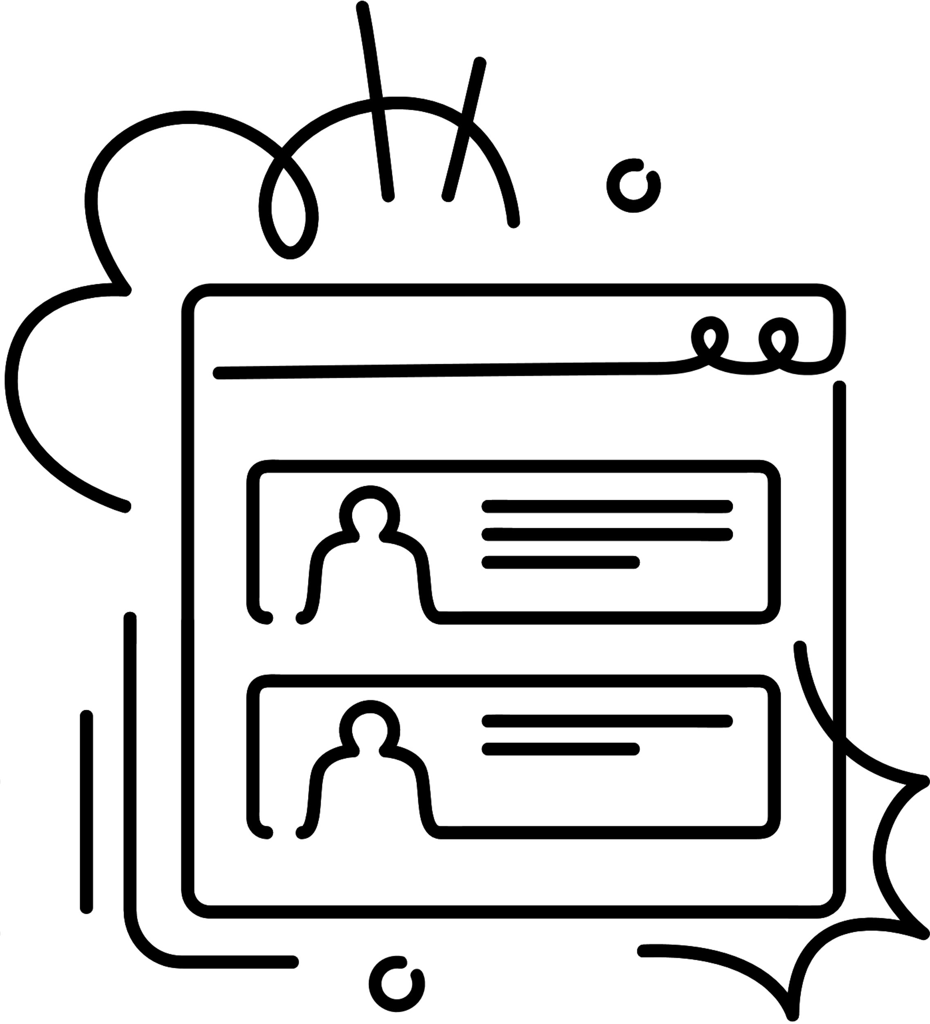

USING POLICIES & PROCEDURES IN PRACTICE
Understanding and Interpreting Policies:
Ensure that employees understand the content and intent of policies and procedures.
Adherence and Compliance:
Emphasize the importance of adhering to policies and procedures in daily work.
Seeking Clarification and Feedback:
Establish channels for employees to provide feedback on the effectiveness or practicality of policies and procedures.
Actively address concerns and consider feedback for future updates.
Continuous Improvement and Adaptation:
Foster a culture of continuous improvement by regularly evaluating the relevance and effectiveness of policies and procedures.

Slide 16
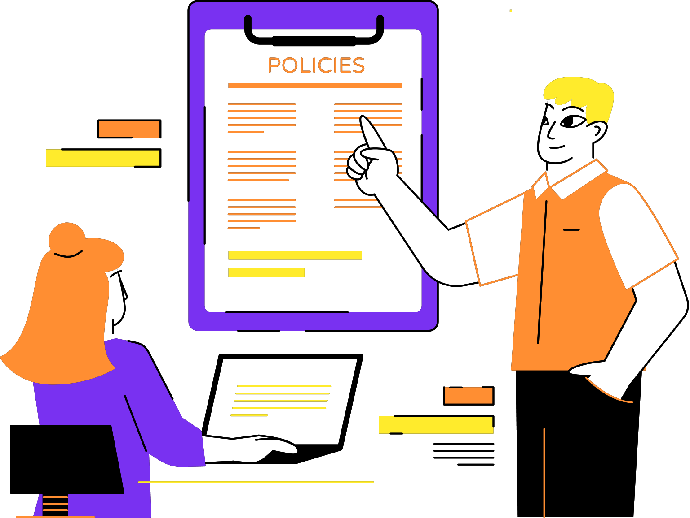
COMMON POLICIES AND PROCEDURES
A company's policies and procedures provide structure and consistency.
Common policies and procedures include those related to safety, ethics, and communication.
Examples: HR policy, Employee Code of Conduct, Acceptable Usage Policy, Information Security Policy, Etc.
Understanding and following these policies and procedures is essential for a safe and productive workplace.

Slide 17

POLICY REVIEW AND REVISION PROCESS
Regular review schedule:
Set a frequency (e.g., annually) for reviewing policies and procedures to ensure they remain current and aligned with organizational needs.
Stakeholder involvement:
Engage policy owners, subject matter experts, and relevant departments in the review process for diverse perspectives and expertise.
Revision process:
Collaborate with stakeholders to draft revised policy language, ensuring clarity, consistency, and alignment with goals and legal requirements.
Approval and documentation:
Seek necessary approvals and maintain a record of the review and revision process, including dates and changes made.
Communication and implementation:
Communicate the updated policies to relevant stakeholders and provide guidance on transitioning to the revised policies.

Slide 18

POLICY DOCUMENTATION REPOSITORY AND ACCESSIBILITY
Centralized repository: Establish a centralized and secure location for storing policy documents.
Online platforms: Utilize digital platforms or intranet systems for easy access to policy documents.
Categorization and organization: Implement a logical system for organizing policies based on topics or departments.
Regular updates: Maintain an up-to-date repository by promptly uploading revised policies.
Version control: Establish a version control mechanism to track policy revisions.
Employee accessibility: Communicate instructions on how to access the policy repository to all employees.

Slide 19

WHY POLICIES AND PROCEDURES MATTER
Policies and procedures provide a framework for consistency, fairness, and efficiency.
They ensure compliance with laws and regulations and mitigate risks.
They promote a positive work culture and protect employees, customers, and the company's reputation.
Adhering to policies and procedures is crucial for the success and sustainability of any organization.

Slide 20
POLICY EXCEPTIONS AND DEVIATIONS
Policy Exceptions: Define processes for requesting and approving exceptions to policy requirements.
Risk Management: Monitor and mitigate risks associated with policy exceptions to minimize potential negative impacts.
Compliance Considerations: Ensure that exceptions comply with applicable laws, regulations, and ethical standards.
Communication: Communicate approved policy exceptions to relevant stakeholders to maintain transparency and consistency.
Periodic Review: Regularly review policy exceptions to assess their continued relevance and necessity.
Continuous Improvement: Use insights from exceptions to refine policies and procedures and enhance their effectiveness.

Slide 21
Q AND A
What is the purpose of having policies and procedures in an organization?
How do policies and procedures contribute to maintaining consistency in decision-making and actions?
What are some potential risks of not having well-defined policies and procedures in place?
What strategies can organizations use to ensure effective communication and awareness of policies and procedures among employees?
How can policies and procedures help organizations comply with legal and regulatory requirements?

Slide 22
Q AND A (CONT.)
Have you ever encountered a situation where policies and procedures helped resolve a problem or guide decision-making? Can you share that experience?
Can you provide an example of a policy or procedure that you find particularly useful in your role or department?
How do you ensure that new employees are familiarized with the relevant policies and procedures during their onboarding process?
How do you see policies and procedures contributing to a safer working environment in your organization?

Slide 23

POLICY OWNERSHIP AND RESPONSIBILITY
Define Policy Ownership: Clarify the concept of policy ownership and its importance in policy management.
Assign policy owners for each policy within the organization.
Clearly define the roles and responsibilities of policy owners, including policy development, maintenance, and updates.
Encourage collaboration between policy owners and relevant stakeholders to ensure policy effectiveness and alignment with organizational goals.
Highlight the need for effective communication and coordination between policy owners and stakeholders to ensure policy understanding and compliance.

Slide 24


THANK YOU

Slide 25

ANY QUESTIONS

